Slide 1
NoC Performance Analysis Tool with Hybrid Arbitration

Slide 2
Agenda
Overview of .Dot file changes
Handling after saturation cases
Next steps & discussion

Slide 3
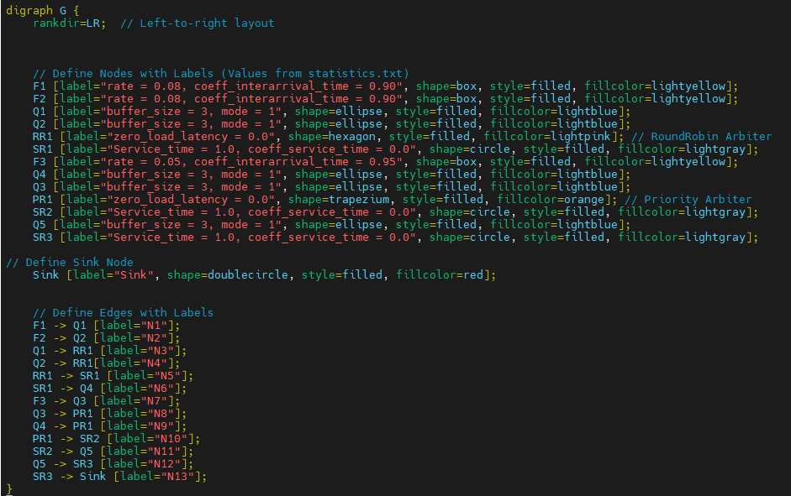
Changes in .Dot File
Fn [label="rate = ?, coeff_interarrival_time = ?“ ]
Qn [label="buffer_size = ?, mode = ?“]
RRn [label="zero_load_latency = ?“]
PRn [label="zero_load_latency = ?“]
SRn [label="Service_time = 1.0, coeff_service_time = 0.0"
Sink [label="Sink“]

Slide 4
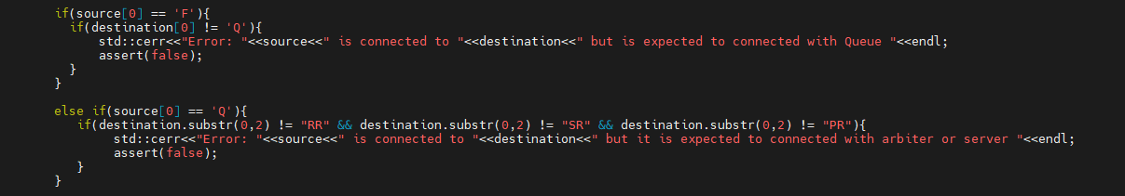
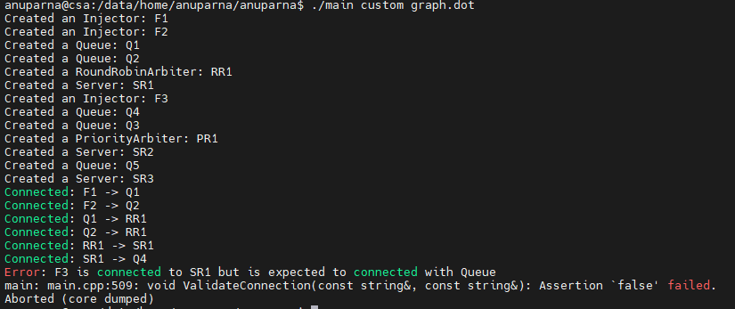
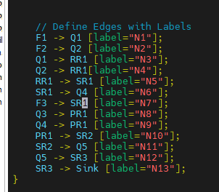
Validate Connection
Injector(Fn) Queue(Qn)
Queue(Qn) Server
Arbiter
Server(SRn) Queue
Sink
Merge
Arbiter(RRn
or PRn) Server(SRn)
Split Queue

Slide 5
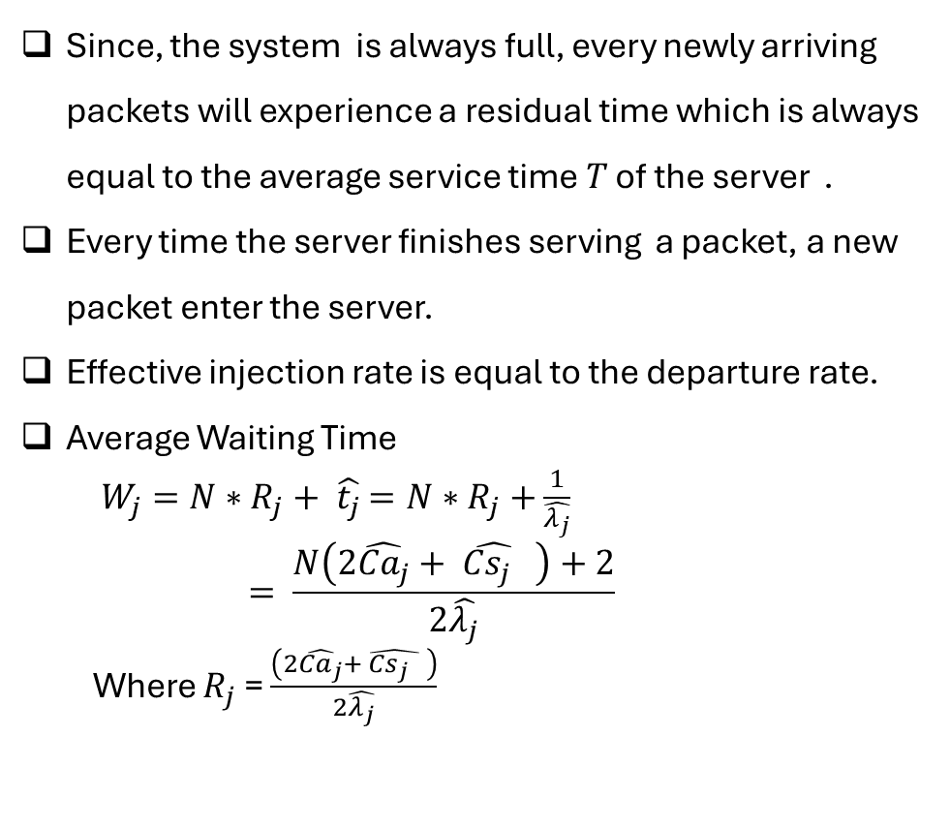
Waiting Time Calculation with High Injection Rate and Finite Buffer
Since, the system is always full, every newly arriving packets will experience a residual time which is always equal to the average service time $T$ of the server .
Every time the server finishes serving a packet, a new packet enter the server.
Effective injection rate is equal to the departure rate.
Average Waiting Time
$W_{j}=N∗R_{j}+ \hat{t_{j}}$ $=N∗R_{j}+$ $\frac{1}{\hat{λ_{j}}}$
$$= \frac{N\left(2\hat{{Ca}_{j}}+ \hat{{Cs}_{j} } \right)+2}{2\hat{λ_{j}}}$$
Where $R_{j}$ = $\frac{\left(2\hat{{Ca}_{j}}+ \hat{{Cs}_{j} } \right)}{2\hat{λ_{j}}}$
1
2
3

Slide 6
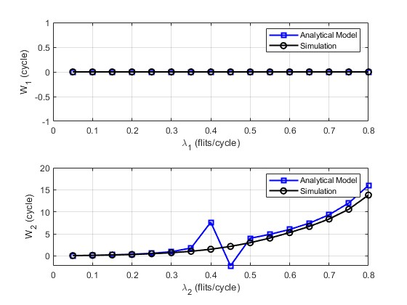
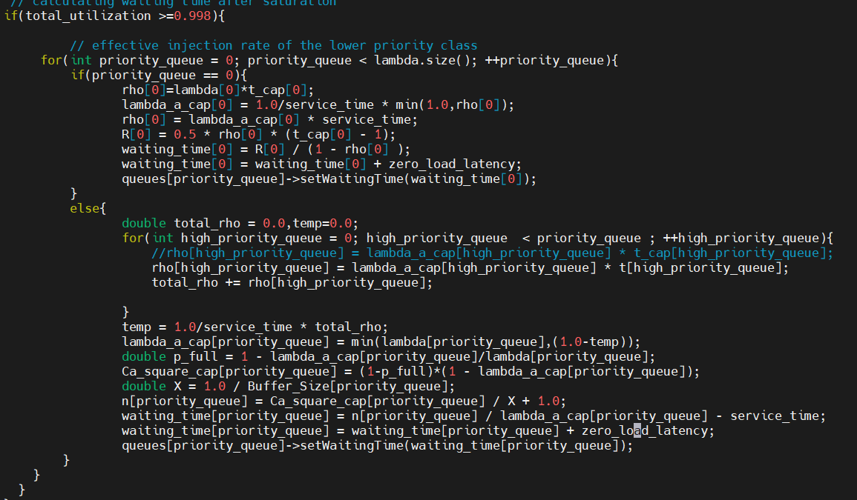

Simulation Vs Analytical model Result using modified concept(PR model)
Computing Effective Injection Rate ($\hat{λ_{j}})$ at high Traffic Injection Rate.
$\hat{λ_{j}}= \left\{\begin{aligned}\frac{1}{T}min\left(1, ρ_{j}\right), j=1 \\ min\left(λ_{j} , \left(1− \frac{1}{T}\sum_{i=1}^{j−1}{\hat{ρ_{j}}}\right)\right), 1<j ≤J\end{aligned}\right.$
Calculating the Residual Time
$R_{j}$ = $\frac{\left(2\hat{{Ca}_{j}}+ \hat{{Cs}_{j} } \right)}{2\hat{λ_{j}}}$
Waiting time :
$$W_{j}= \frac{N\left(2\hat{{Ca}_{j}}+ \hat{{Cs}_{j} } \right)+2}{2\hat{λ_{j}}}$$
MAPE_1 = 0 MAE_1 = 0
MAPE_2 = 18.4195 MAE_2 = 1.2225

Slide 7
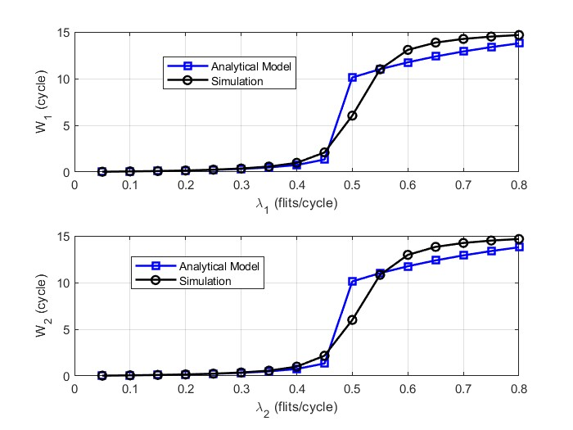
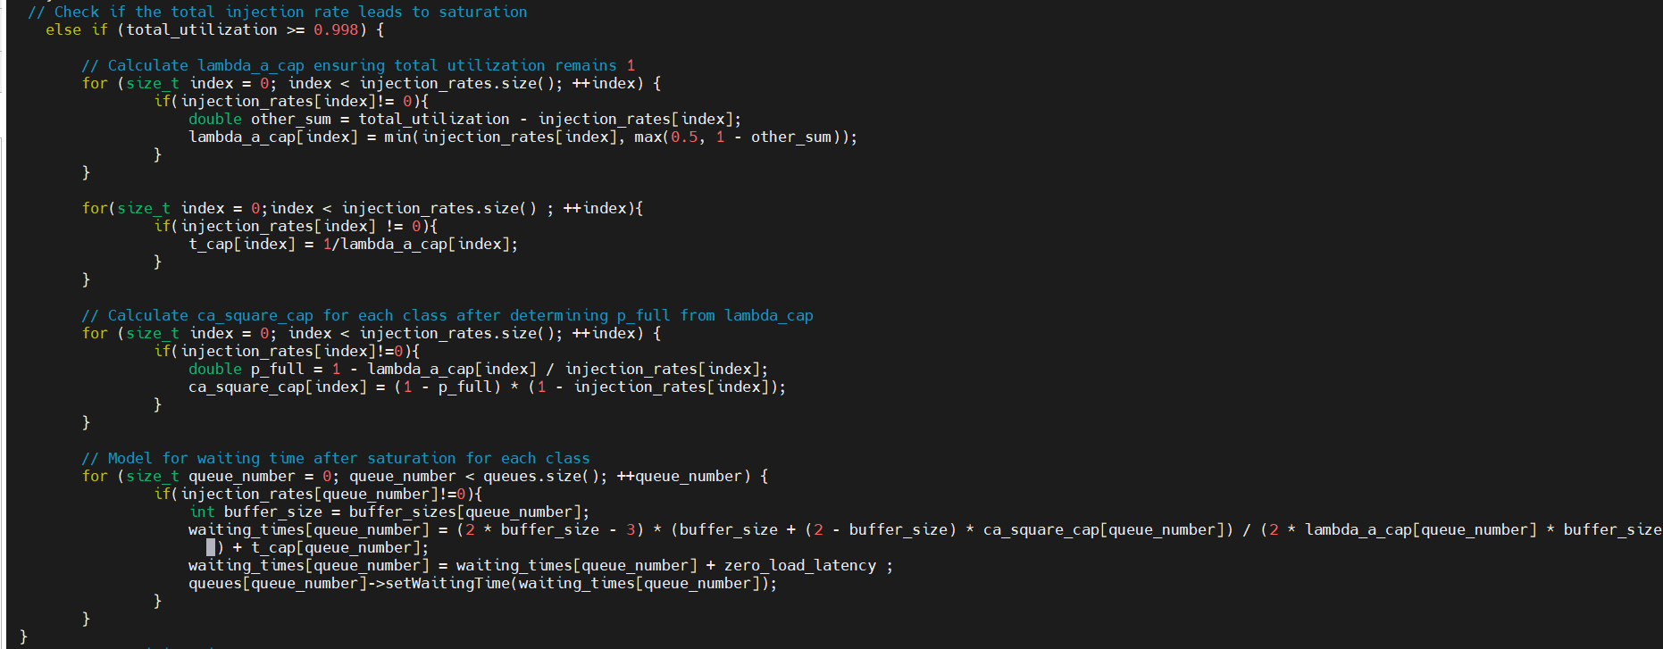
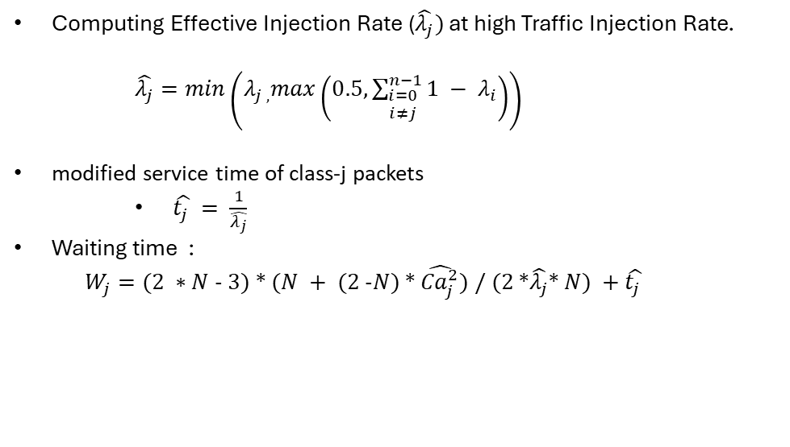
Simulation Vs Analytical model Result using modified concept(RR model)
Computing Effective Injection Rate ($\hat{λ_{j}})$ at high Traffic Injection Rate.
$\hat{λ_{j}}=min\left(λ_{j , }max\left(0.5, \sum_{\begin{aligned}i=0 \\ i≠j\end{aligned}}^{n−1}{1 − λ_{i}}\right)\right)$
modified service time of class-j packets
$\hat{t_{j} }= \frac{1}{\hat{λ_{j}}}$
Waiting time :
$$W_{j}=(2 ∗N − 3) ∗ (N + (2 −N) ∗ \hat{{Ca}_{j}^{2}}) / (2 ∗\hat{λ_{j}}∗ N) +\hat{t_{j} }$$
MAPE_1 = 9.8018 MAE_1 = 0.7139
MAPE_2 = 9.8458 MAE_2 = 0.7208

Slide 8
Next Steps
Equation verification and refinement:
Checking and adjusting equations to ensure accuracy

